Slide 1
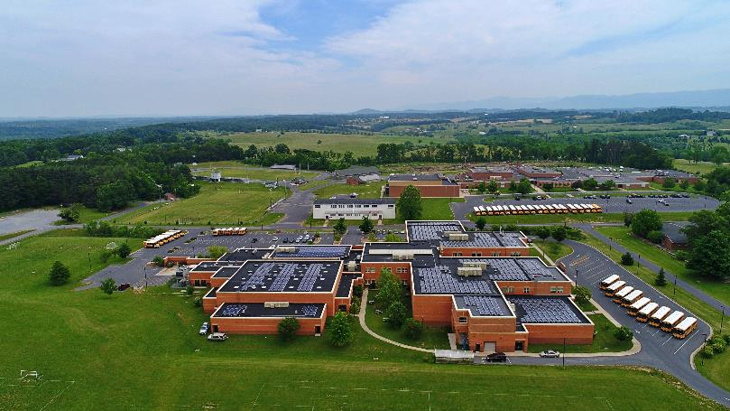
Augusta County Public Schools
May 2022

Slide 2
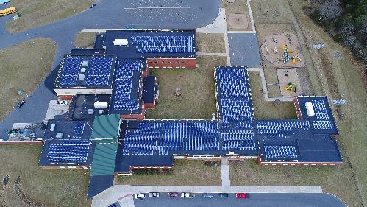
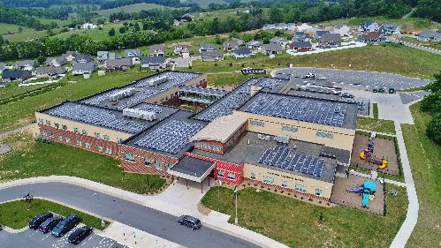
ACPS Solar in Two Phases
Phase I – 1.8MW of roof and ground-mounted solar
Phase II – 1.9MW of solar + 400msf of roof restoration
9.5 million kWh of clean electricity generated to date
170 million kWh expected over lifetime of arrays
$228k in total electricity savings + credits to date
$12 million in projected savings over lifetime of arrays
Avoided >6700 metric tons of CO2 to date
Equivalent to planting >100,000 trees
Facility upgrades
Educational Enhancements
Wilson Elementary School
Riverheads Elementary School

Slide 3
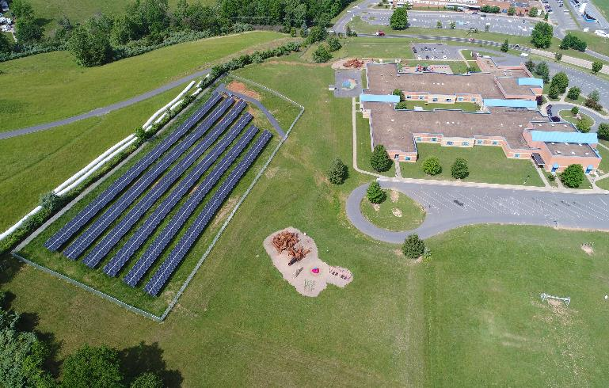
Economic Savings To Date
$50k —net electricity savings
$178k—SREC cash payments
$5m —avoided roof replacement __________________________
$5,228,000 savings to date
>$17 million projected savings over lifetime of array
Wilson Elementary School

Slide 4
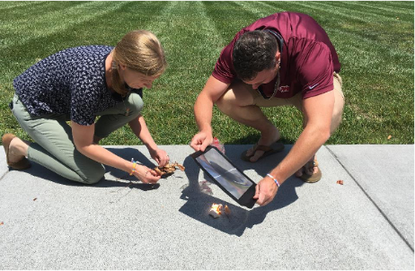
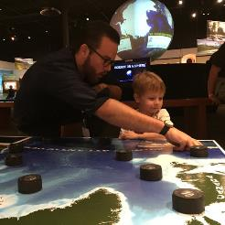
Throwing Solar Shade Program
Students from ACPS participated in 10-week TSS program with the Science Museum of Virginia’s chief scientist Dr. Jeremy Hoffman
Students chose their topics and conducted their own research
Independent evaluation by Dr. David Naff, Associate Director of MERC at VCU
‘Students experienced growth across all domains in the five Cs, with particular growth in their communication and creativity and innovation skills.’ –Dr. Naff
Three ACPS students presented findings at Department of Energy’s Solar Decathlon in December 2020

Slide 5
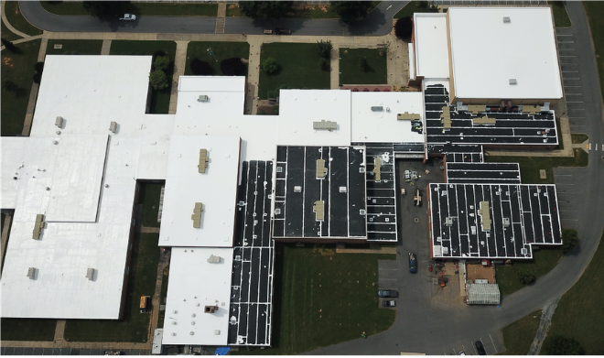
Resilient Solar + Roof Restoration®
Over 400msf of roof restored at Wilson Memorial HS, Stuarts Draft HS, and Gordon Stewart MS
Avoided cost savings >$5m
Avoided tear-off and landfilling
Restoration cost amortized over life of solar project to shift from CAPEX budget to OPEX

Slide 6
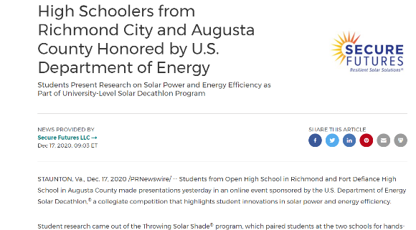
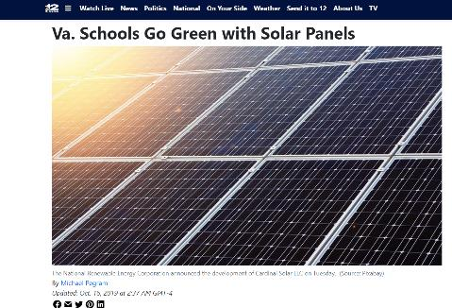
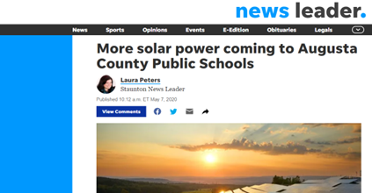
Community Response

