Slide 1
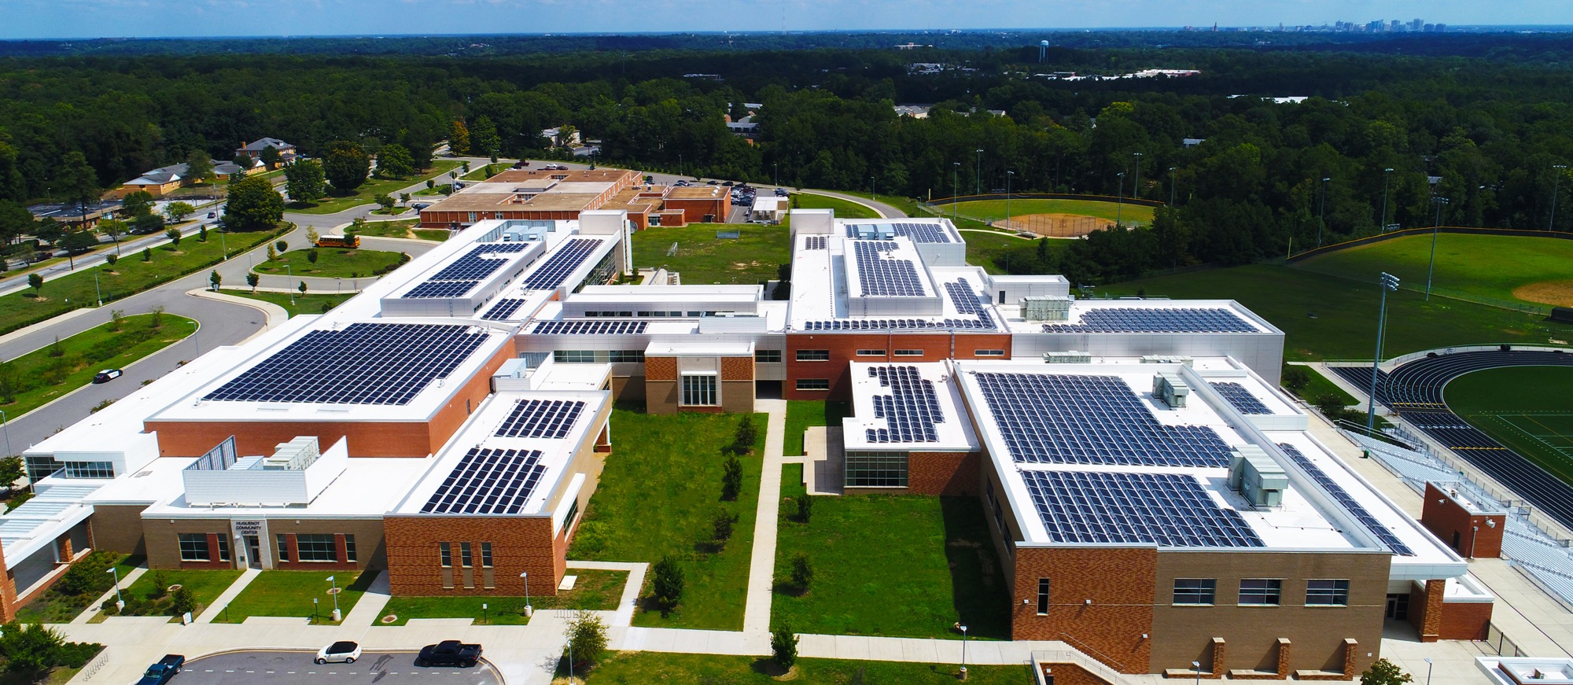
Your Solar Proposal
[Place Customer Logo Here]
INSERT DATE HERE
Presented by Name Goes Here

Slide 2
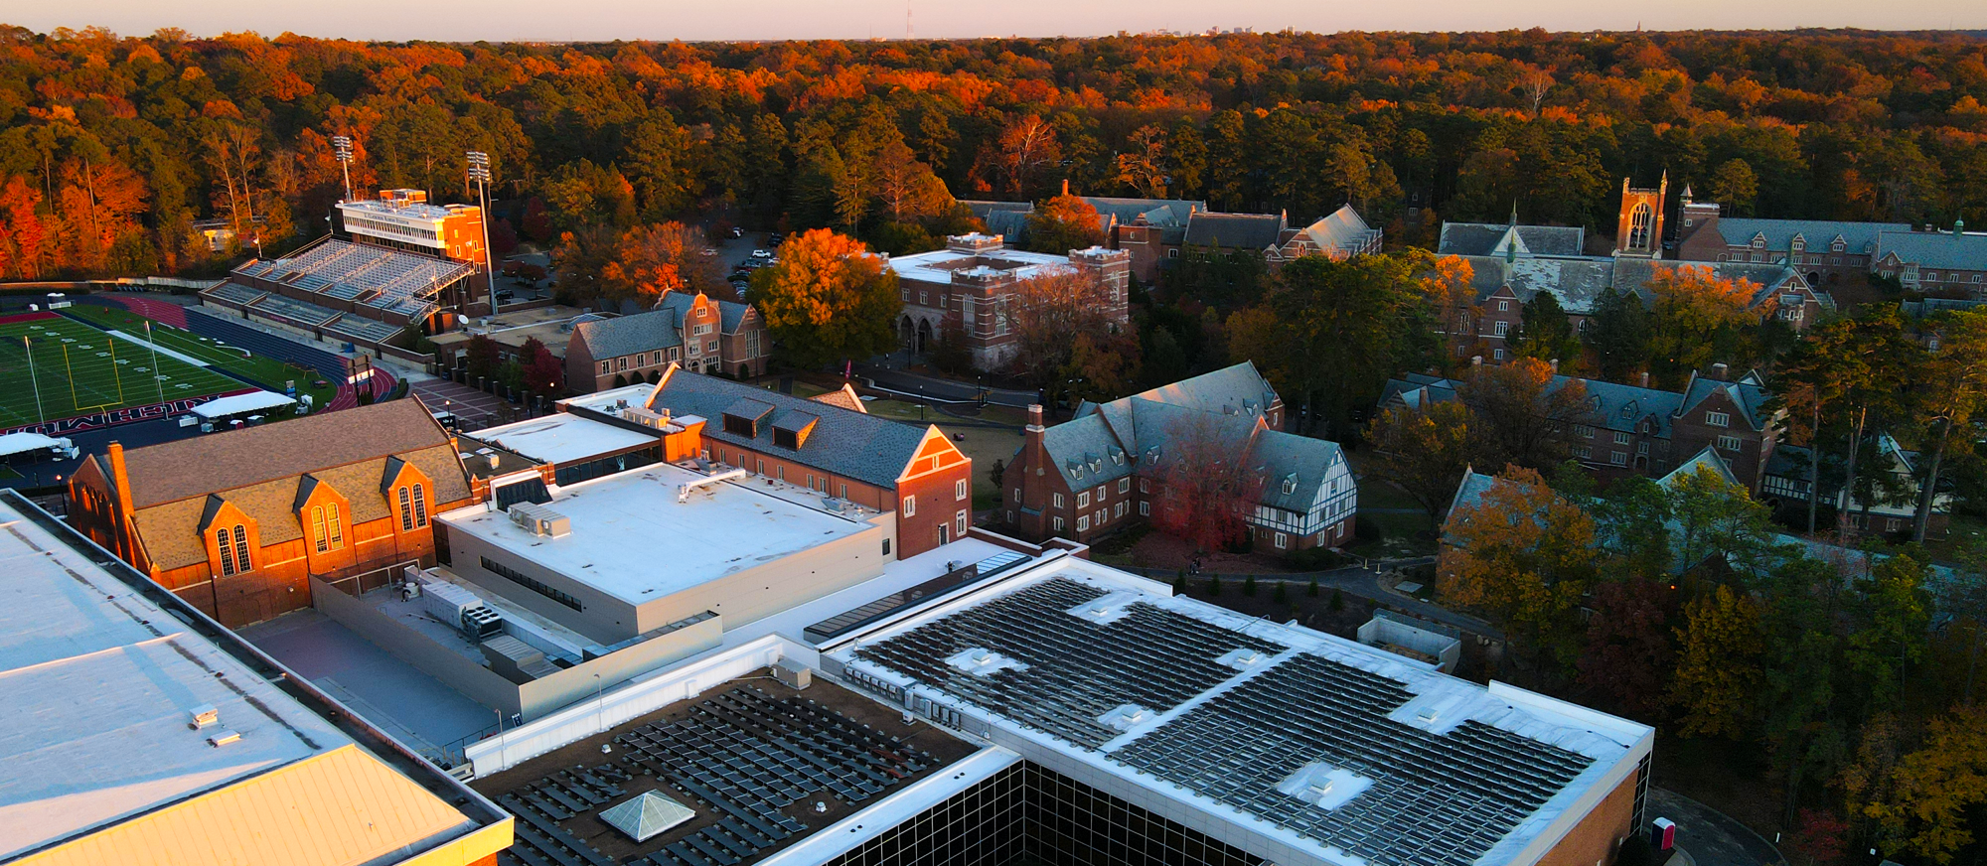
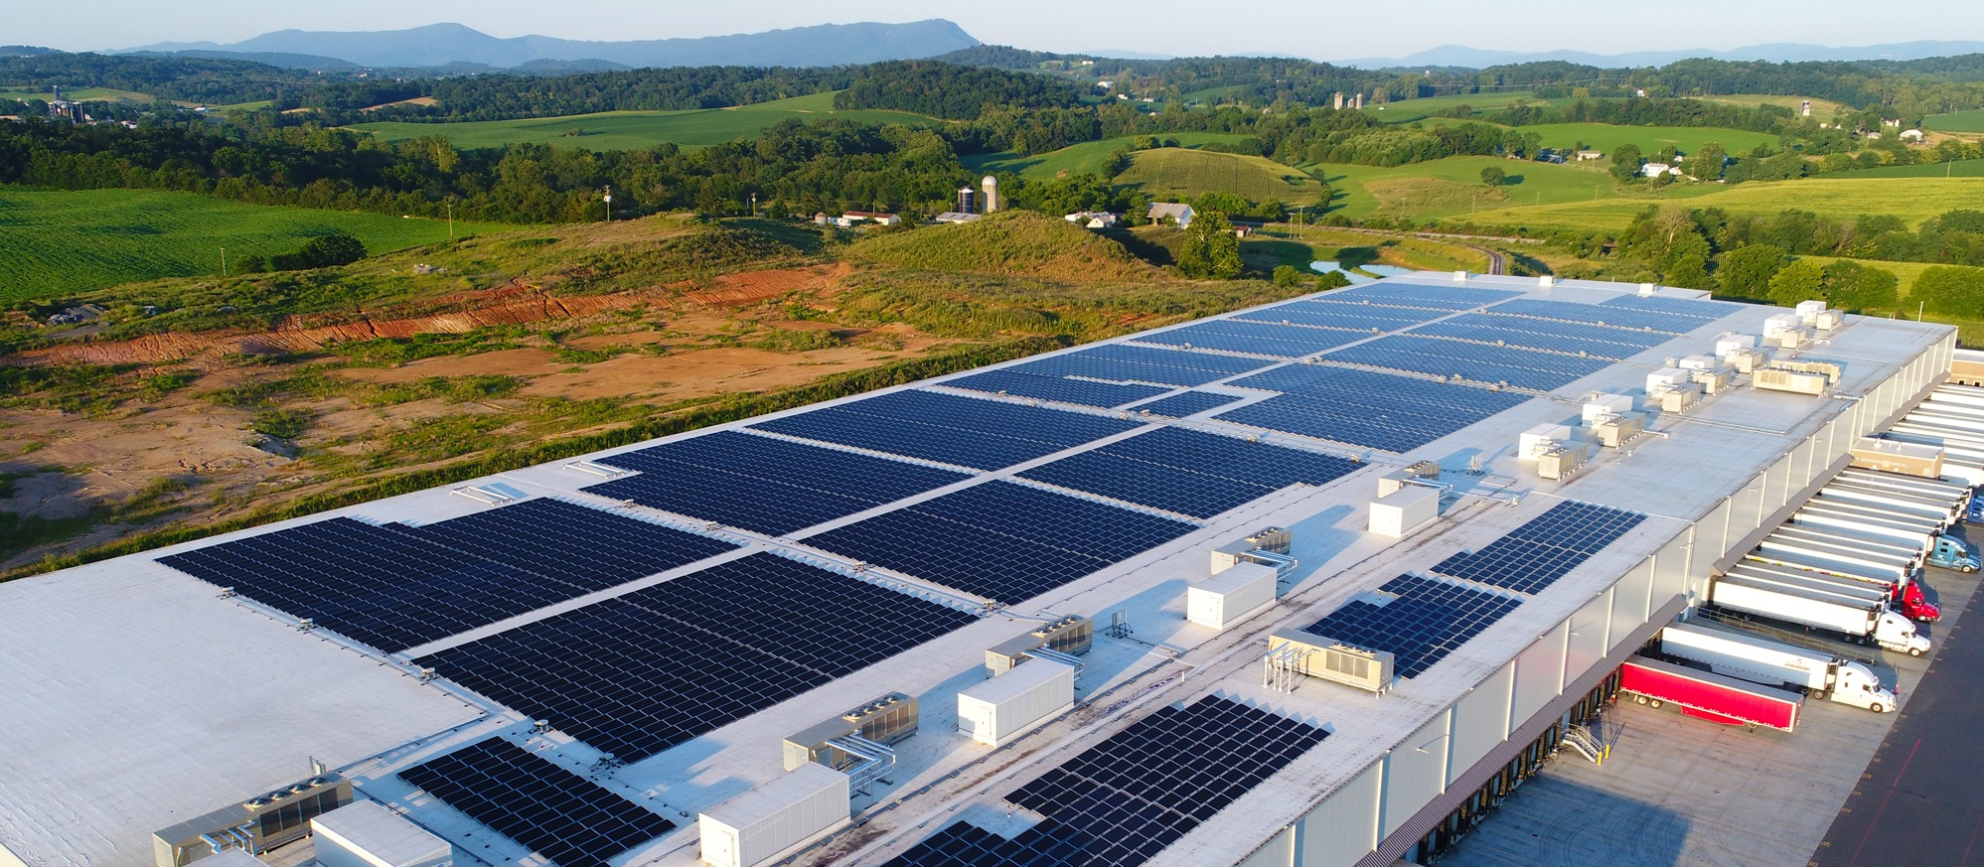
Your Solar Proposal
[Place Customer Logo Here]
INSERT DATE HERE
Presented by Name Goes Here

Slide 3
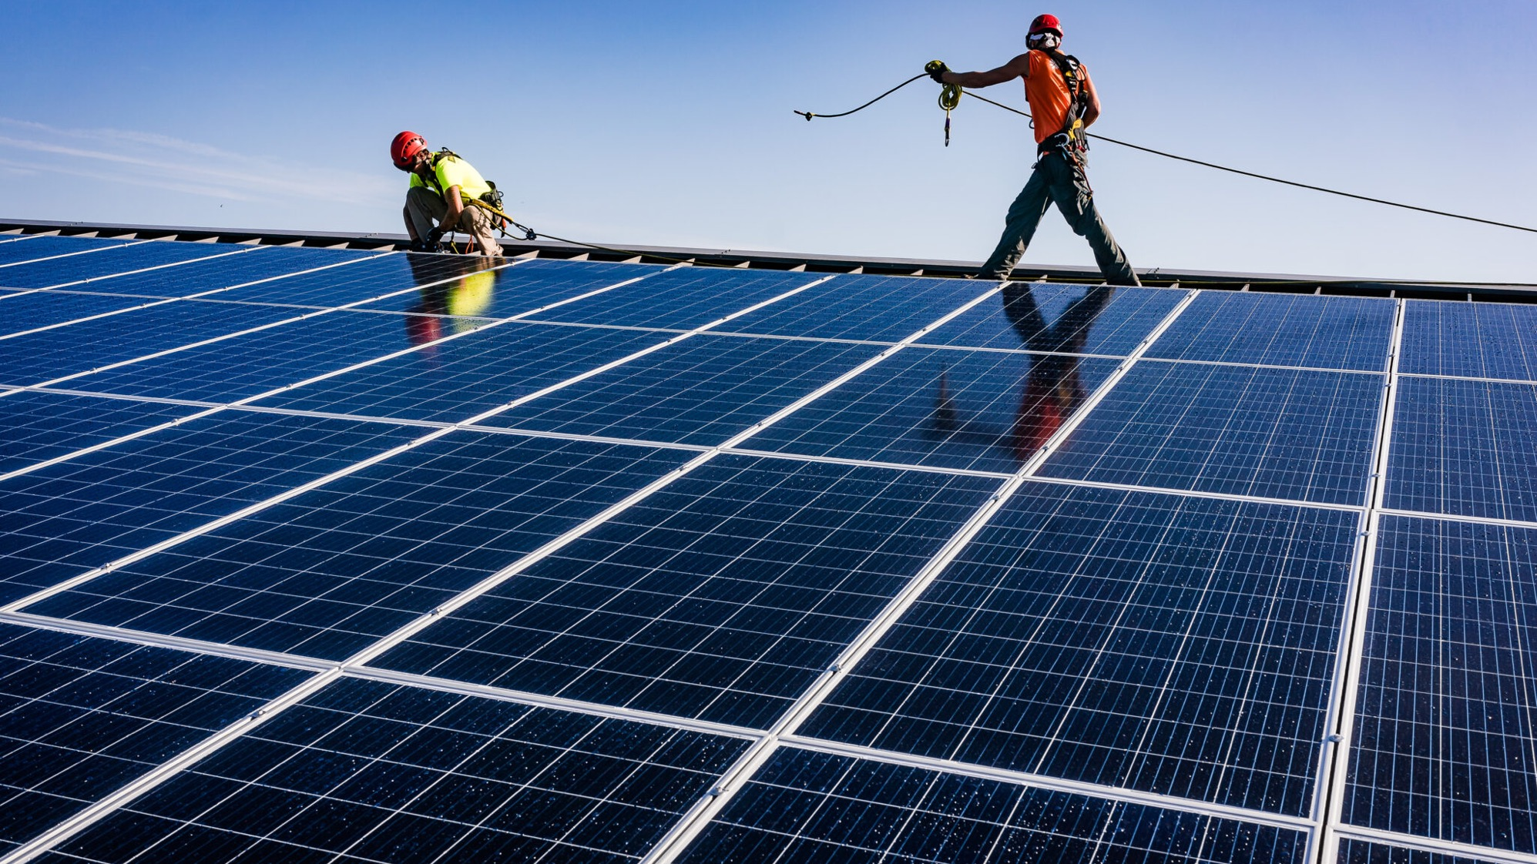
OUR MISSION
We use the power of innovation and partnerships to accelerate the transition to clean, affordable solar electricity, build stronger, more resilient organizations, and engage people and communities working to create a healthier world.

Slide 4
WHO WE SERVE
On-site solar with no upfront capital cost for:
K-12 SCHOOLS
UNIVERSITIES
HOSPITALS
COLD-STORAGE WAREHOUSES
GOVERNMENTS
BUSINESSES

Slide 5
HOW WE DO IT
1
2
3
design
FINANCE
BUILD, OWN, OPERATE & MAINTAIN

Slide 6
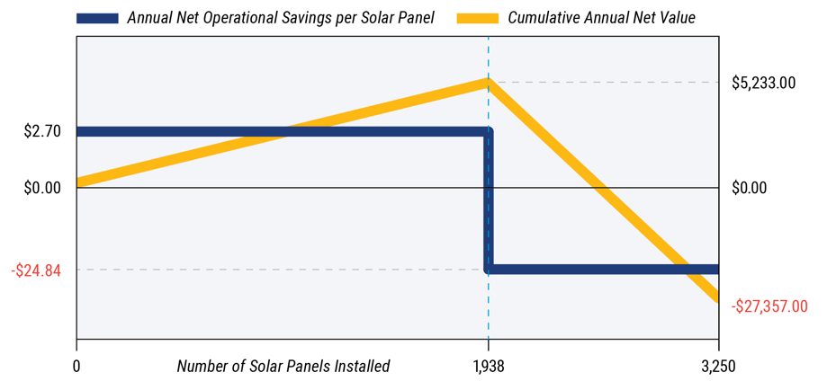
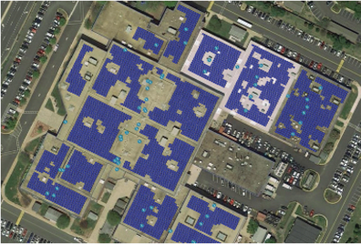
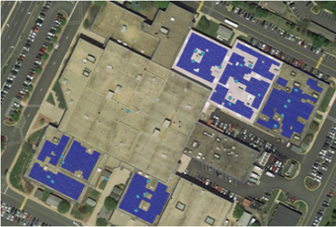
HOW WE DESIGN
More solar panels are not always better. S³ Solar Systems Sizing, our unique and trademarked holistic approach, includes HelioScope analysis to optimize roof layout and system azimuth and tilt angle, roof warranty and structural analysis, building electrical system evaluation, customer electrical usage and peak demand analysis—so we maximize solar savings, not solar panels.
SCENARIO A:
MAXIMIZING SOLAR PANELS
SCENARIO B:
MAXIMIZING CUSTOMER SAVINGS
3,250 SOLAR PANELS
1,938 SOLAR PANELS
ANNUAL SAVINGS -$27,357
ANNUAL SAVINGS $5,233

Slide 7
HOW WE FINANCE
BUY
LEASE
SOLAR PPA
SOLAR SGA®
No Upfront Capital Cost
No Balance Sheet Impact
No Performance Risk
No Maintenance Responsibility
No Technical Expertise Required
Non-Profits Benefit from Tax Incentives
Allowed in Most Areas
Payback Period
Partially*
6-10 years
Immediate
Immediate
Immediate
*The Inflation Reduction Act of 2022 enabled non-taxable entities to take the solar equipment tax credit as a cash payment. But non-taxable entities are still unable to take advantage of equipment depreciation.

Slide 8
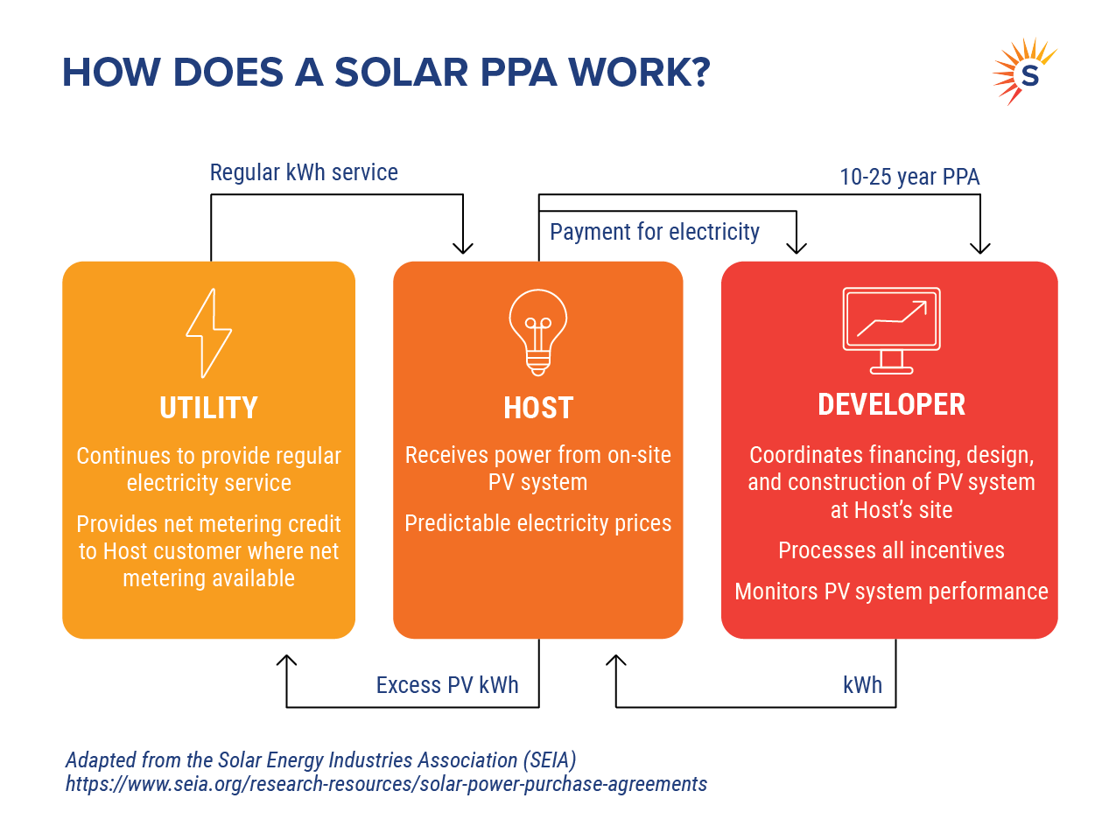
POWER PURCHASE AGREEMENT

Slide 9
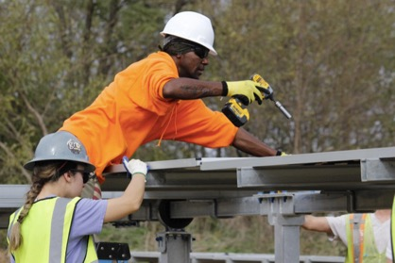
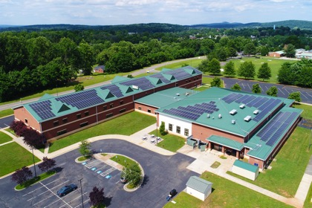
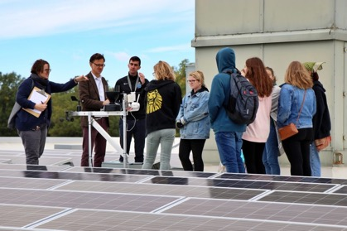
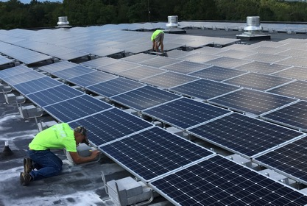
HOW WE BUILD, OWN, OPERATE & MAINTAIN
build
OWN
OPERATE
MAINTAIN
We employ top-tier construction partners and equipment to achieve the highest quality solar system.
We cover upfront capital costs and you pay monthly for services out of your operating budget.
We monitor performance and provide a complete package of related services like boosting your eco-friendly branding and, for schools, educational programs.
We perform any required maintenance to keep solar equipment producing at its top capacity.

Slide 10
OUR TRACK RECORD
Secure Solar Futures has established itself as a trustworthy provider, delivering exceptional service and satisfaction to our customers.
2004
117
37
SECURE SOLAR FUTURES FOUNDED
INDIVIDUAL PROJECTS
MW INSTALLED
COMPANY FIRSTS
First PPAs offered in Virginia
First solar company in Virginia to become a B Corp
First PPA offered in West Virginia (Calhoun Co.)
First Solar SGA® offered for states without PPAs

Slide 11
SELECTED CUSTOMERS

Slide 12
SELECTED CUSTOMERS

Slide 13
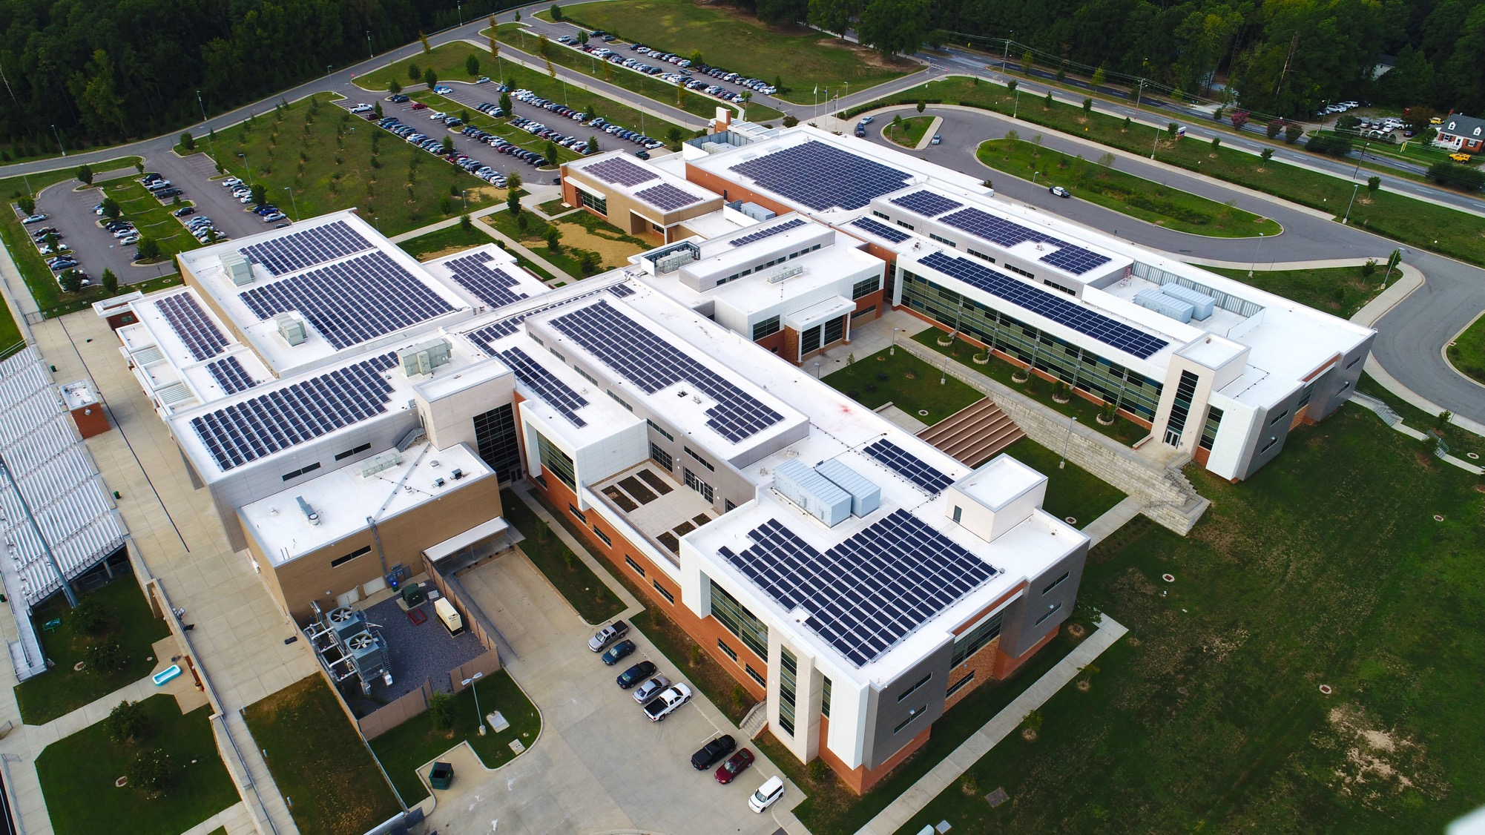
Our Services

Slide 14
SOLAR HAPPENS WHEN UTILITIES RECOGNIZE THAT ENERGY DIVERSIFICATION IS THE FUTURE.
COST OF ELECTRICITY RISES
FEDERAL TAX INCENTIVES ARE AVAILABLE
PUBLIC POLICY MOTIVATES UTILITIES TO ACTION
COST OF PV ADAPTATION DECREASES

Slide 15
VIRGINIA MARKET
Ranked #10 in the US for Installed Solar Capacity*
Most utility territories allow sales of kWh’s through PPAs; our SGA® is an approved option for all other areas
In 2020, Va passed the Clean Economy Act requiring utilities to buy more power from distributed
solar generators
*4,314 MW as of Q1 2023 data from Solar Energy Industries Association

Slide 16
WEST VIRGINIA MARKET
Ranked #48 in the US for Installed Solar Capacity*
In 2021, WV legalized sale of kWh’s through PPAs statewide
In 2023, Secure Solar Futures developed first PPA project in the state with Calhoun County Schools
*31 MW as of Q1 2023 data from Solar Energy Industries Association

Slide 17
NORTH CAROLINA MARKET
Ranked #4 in the US for Installed Solar Capacity*
Solar PPAs are not allowed, but our SOLAR SGA® is an approved option
HB-589 (2017) NCUC creates Electric Generator Lessors Program
*8,407 MW as of Q1 2023 data from Solar Energy Industries Association

Slide 18
SOUTH CAROLINA MARKET
Ranked #14 in the US for Installed Solar Capacity*
Solar PPAs are not allowed, but our SOLAR SGA® is an approved option
In 2019, SC passed the Energy Freedom Act allowing
net metering
*2,427 MW as of Q1 2023 data from Solar Energy Industries Association

Slide 19
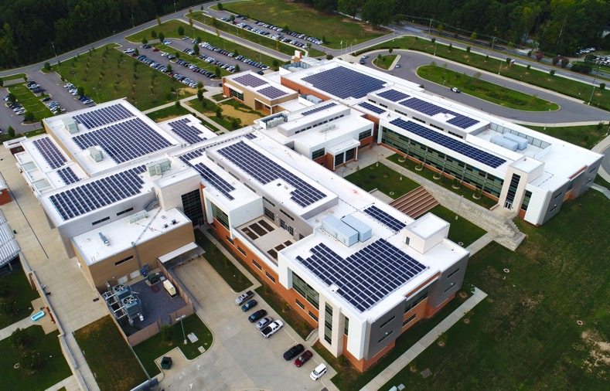
RESILIENT SOLAR + ROOF RESTORATION®
Partnering with Secure Solar Futures means maintaining the integrity of your roof, reducing energy costs, and integrating state-of-the-art technology into your facility systems.
Roof restoration costs less than full replacement and 25-year warranty matches solar PPA term
Cost folded into Solar PPA as operating expense over 15 years to reduce unfunded liabilities in capital budget and eliminate debt
Reduced roof temperature from white roof lowers cooling costs
Maximize savings by combining benefits of Resilient Solar + Roof Restoration®

Slide 20
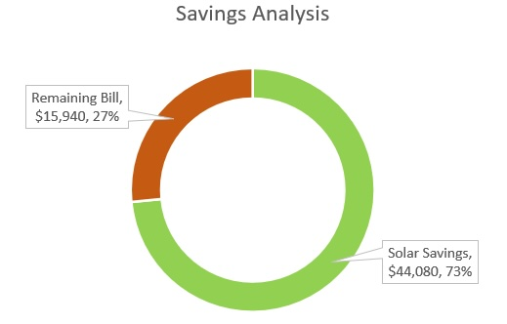
ENERGY MONITORING & ANALYSIS
Our industry-leading solar monitoring system goes where other systems don’t, comparing your cost of solar to your utility rate tariff to take the guesswork out of calculating money savings from solar.
View your solar array’s production in real time
See how much total energy your facility is using
View the impact of solar on your power usage and your electric bill
Calculate your savings from solar
Share the good news with your colleagues through clear, graphical reports
Sample image from energy monitoring system

Slide 21
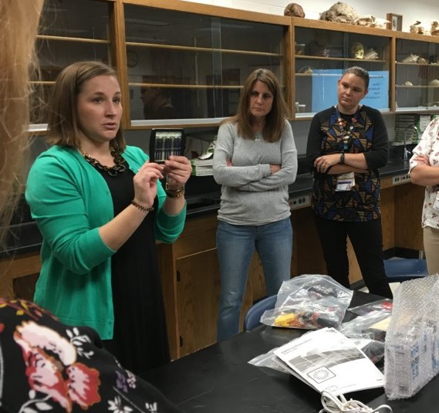
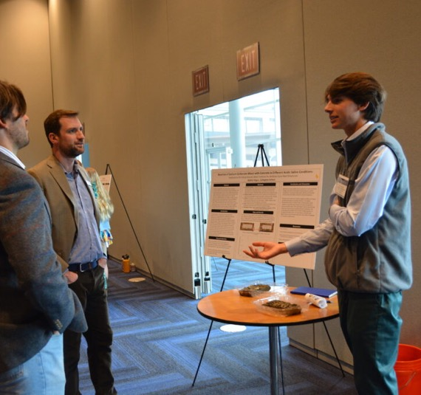
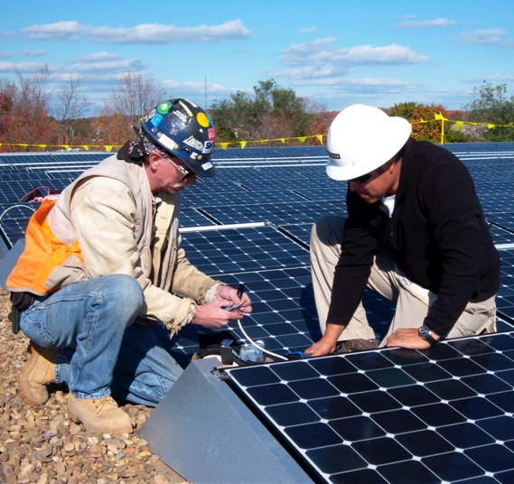
EDUCATION PROGRAMS FOR K-12 SCHOOLS
CLASSROOM CURRICULA
FROM NEED
THROWING SOLAR SHADE®
WORKFORCE
DEVELOPMENT

Slide 22
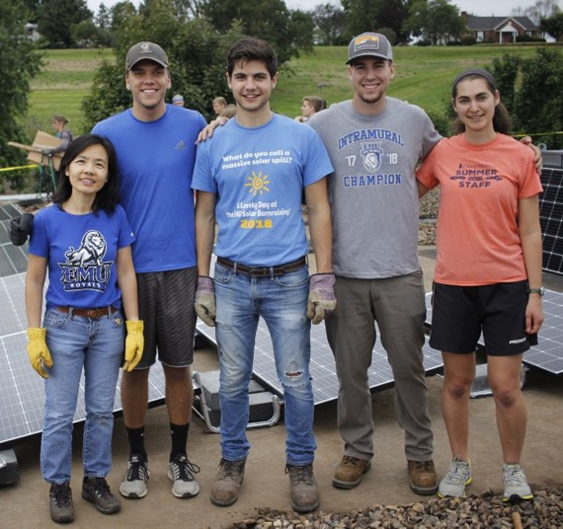
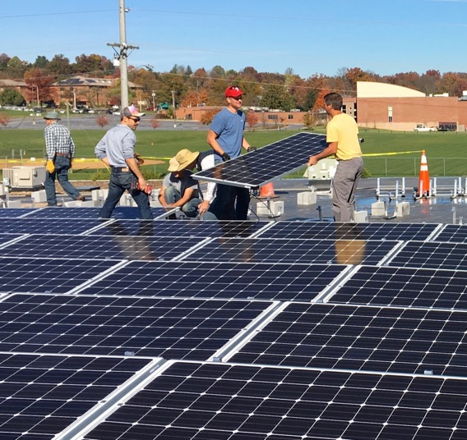
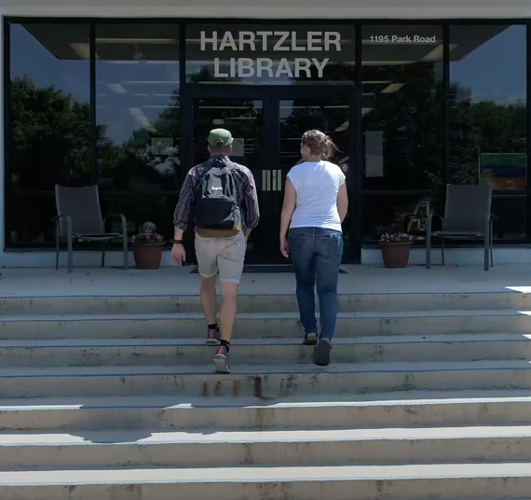
EDUCATION PROGRAMS FOR HIGHER EDUCATION
University Capstone ProjectS
SOLAR BARN
RAISINGS
Workshops on Solar Energy

Slide 23
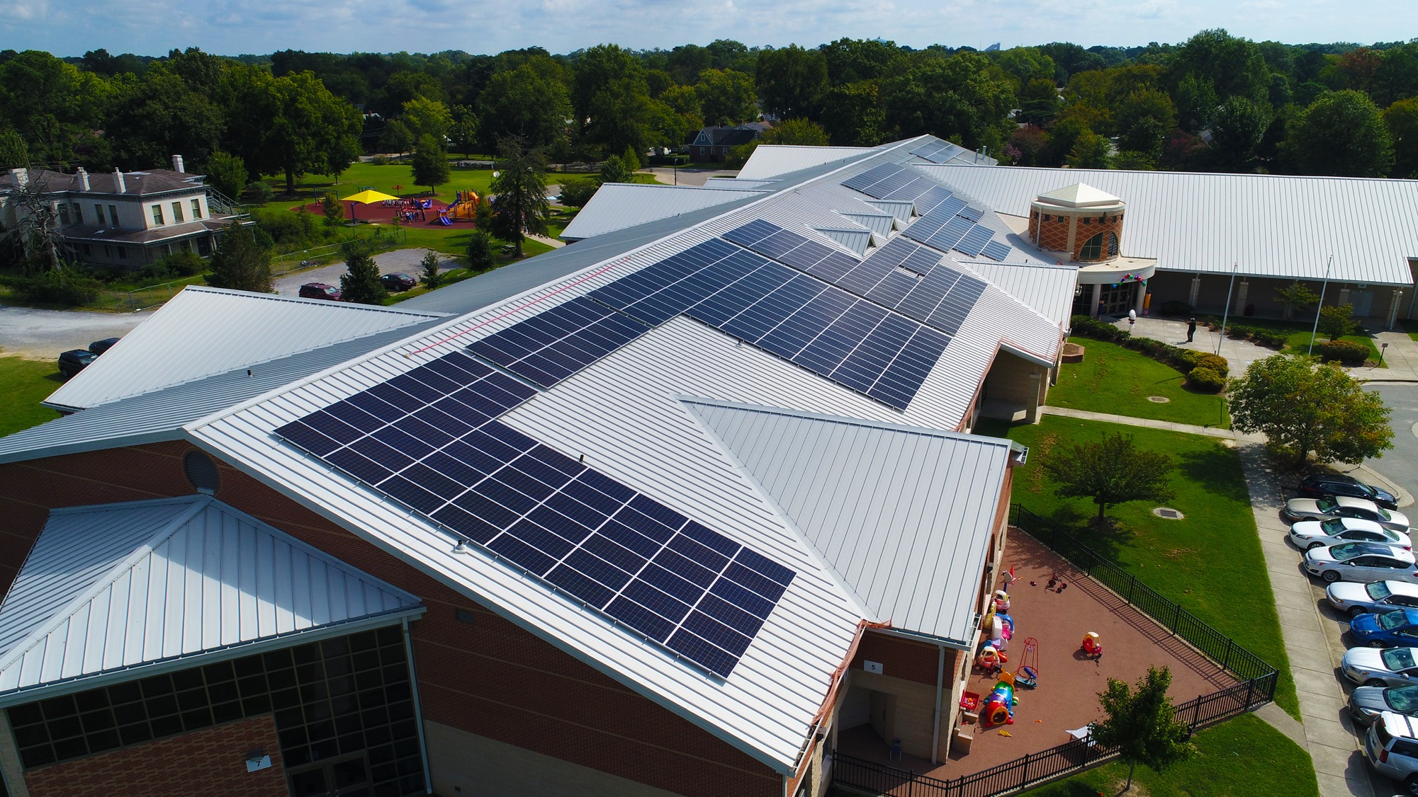
Customer Stories

Slide 24
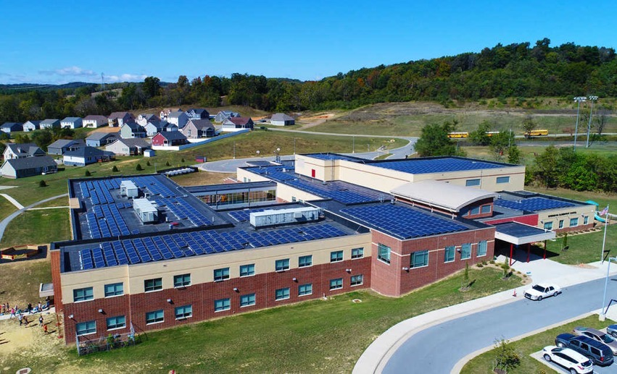
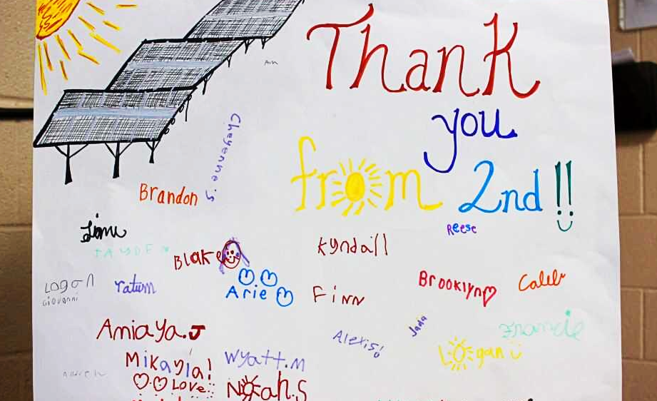
AUGUSTA COUNTY PUBLIC SCHOOLS
A CURRICULUM THAT EVOLVES WITH THE SUN
SYSTEM SIZE 1.8 MW
YEAR INSTALLED 2018
NUMBER OF HOMES SYSTEM COULD POWER 180
CUSTOMER SAVINGS $12 MILLION OVER 20 YEARS

Slide 25
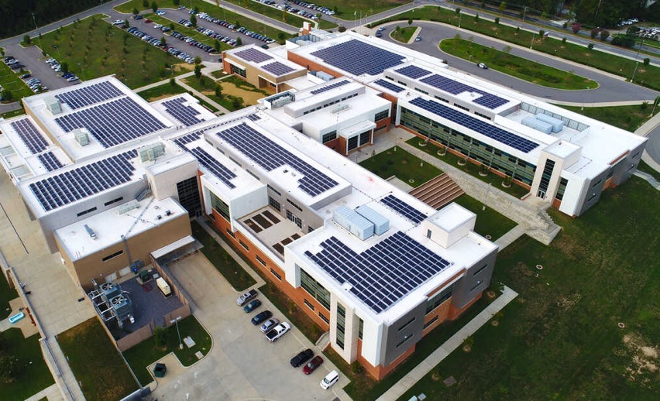
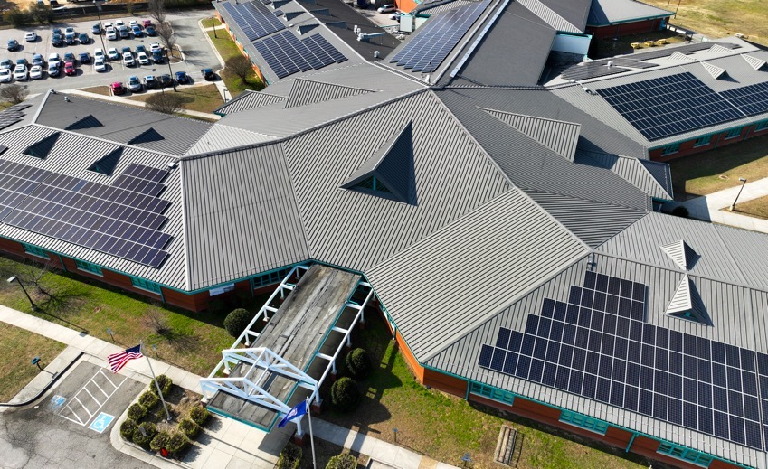
RICHMOND PUBLIC SCHOOLS
SEEING THE FUTURE IN VIRGINIA’S CAPITAL
SYSTEM SIZE 2.87 MW
YEAR INSTALLED 2020
NUMBER OF HOMES SYSTEM COULD POWER 287
CUSTOMER SAVINGS $2 MILLION OVER 20 YEARS

Slide 26
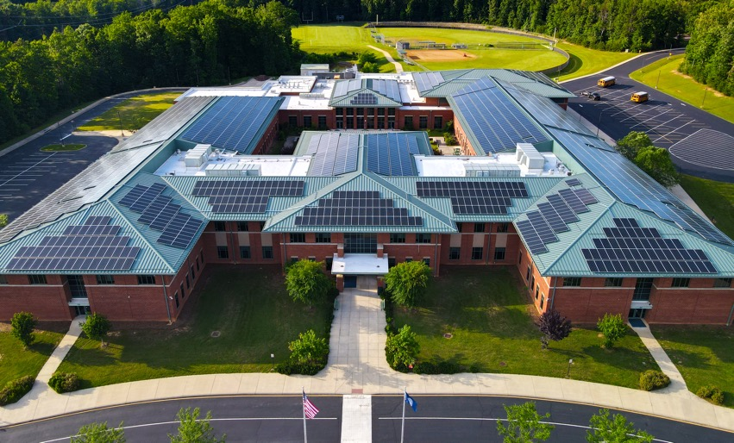
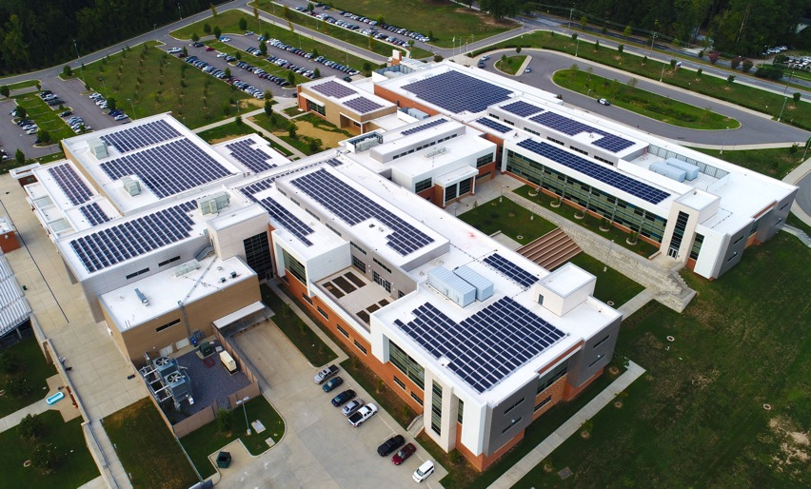
ORANGE COUNTY PUBLIC SCHOOLS
ROOF RESTORATION MAKES MORE BUILDINGS SOLAR READY
SYSTEM SIZE 2.5 MW
YEAR INSTALLED 2020
NUMBER OF HOMES SYSTEM COULD POWER 250
CUSTOMER SAVINGS $16.8 MILLION OVER 35 YEARS

Slide 27
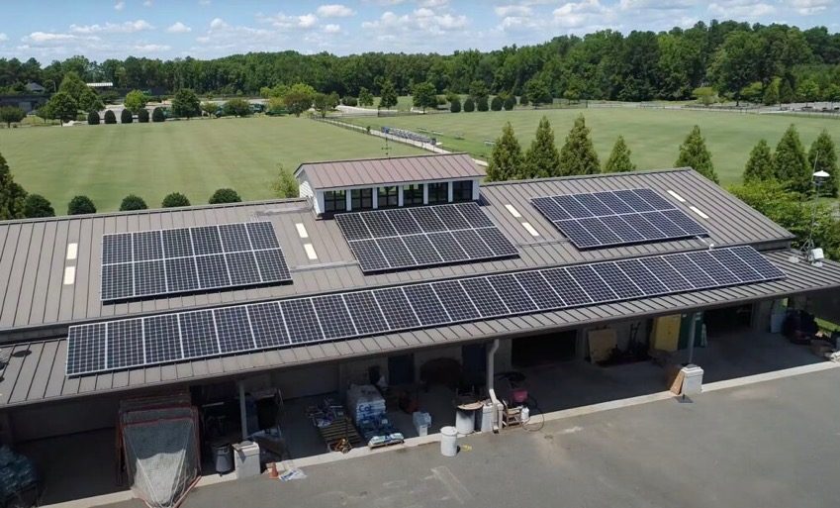
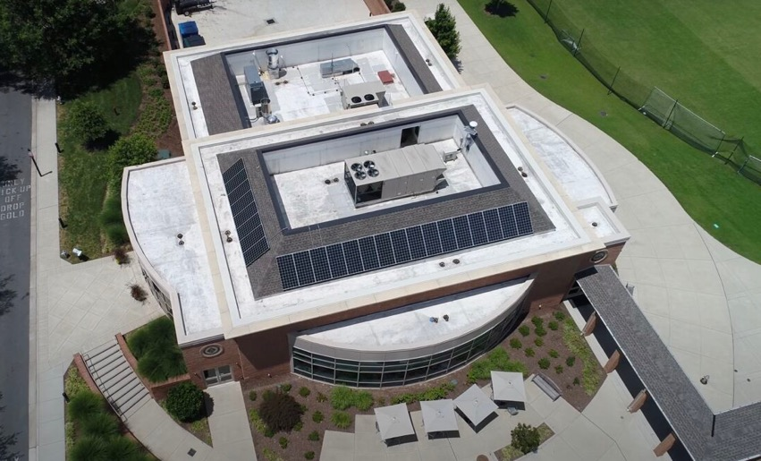
COLLEGIATE SCHOOL
THE FIRST K-12 SCHOOL TO INSTALL SOLAR ON CAMPUS IN RICHMOND, VA
SYSTEM SIZE 94.3 kW
YEAR INSTALLED 2018
NUMBER OF HOMES SYSTEM COULD POWER 10
CUSTOMER SAVINGS $172,000 OVER 35 YEARS

Slide 28
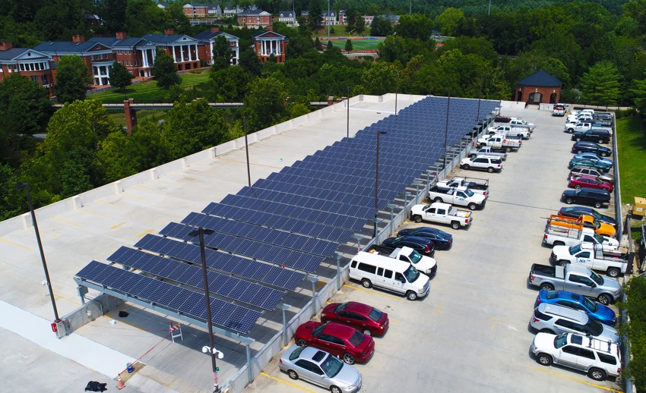
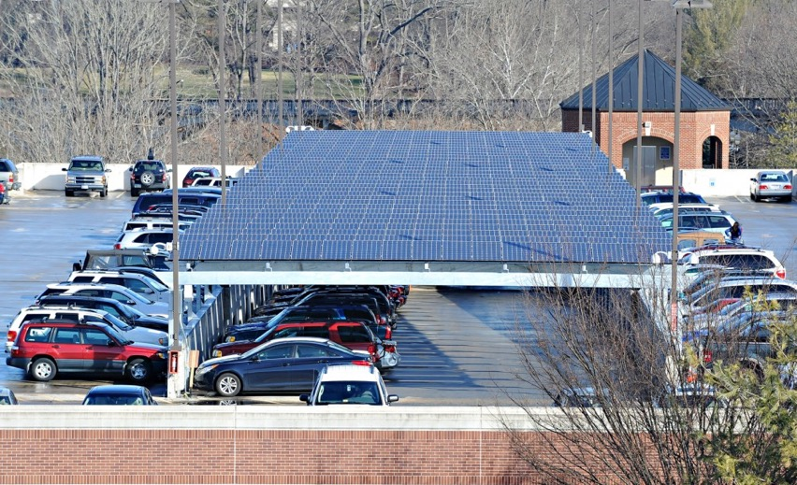
WASHINGTON & LEE UNIVERSITY
ON-CAMPUS SOLAR SHOWS TANGIBLE COMMITMENT TO CLIMATE ACTION
SYSTEM SIZE 444 kW
YEAR INSTALLED 2011
NUMBER OF HOMES SYSTEM COULD POWER 45
CUSTOMER SAVINGS UNAVAILABLE*
*Solar array purchased by customer after 6 years of their 20-year agreement

Slide 29
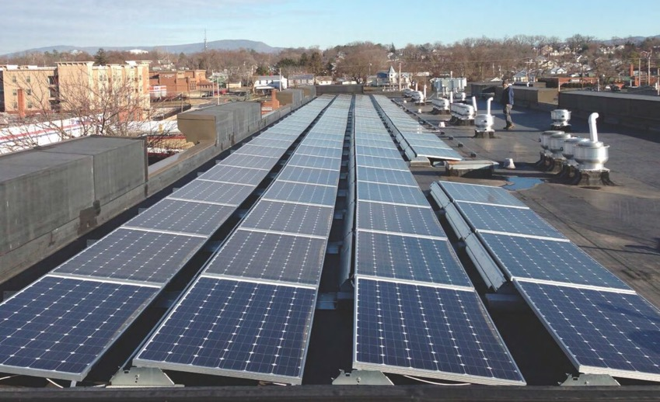
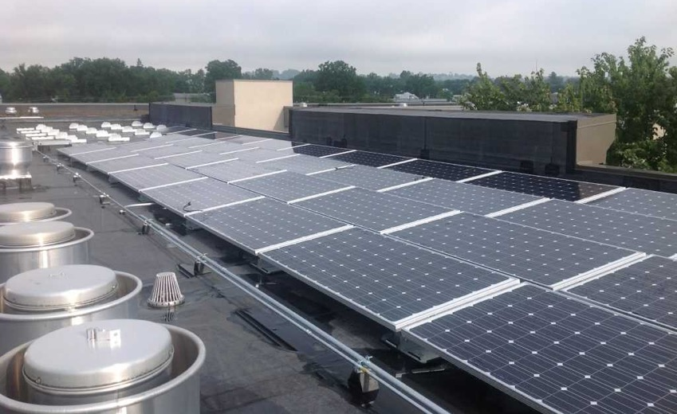
HARRISONBURG HOUSING & REDEVELOPMENT AUTHORITY
A HOUSING AUTHORITY WITH A BIG VISION
SYSTEM SIZE 35 kW
YEAR INSTALLED 2013
NUMBER OF HOMES SYSTEM COULD POWER 3.5
CUSTOMER SAVINGS $135,000 OVER 35 YEARS

Slide 30
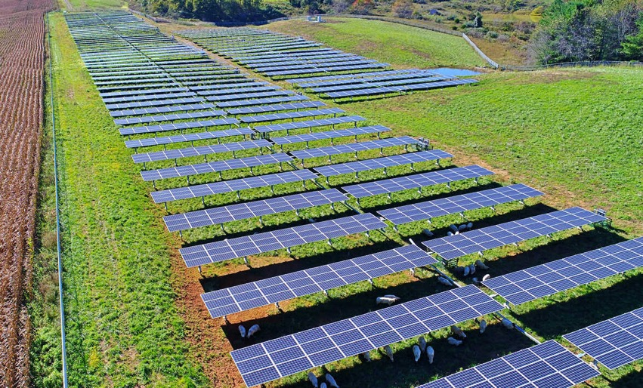
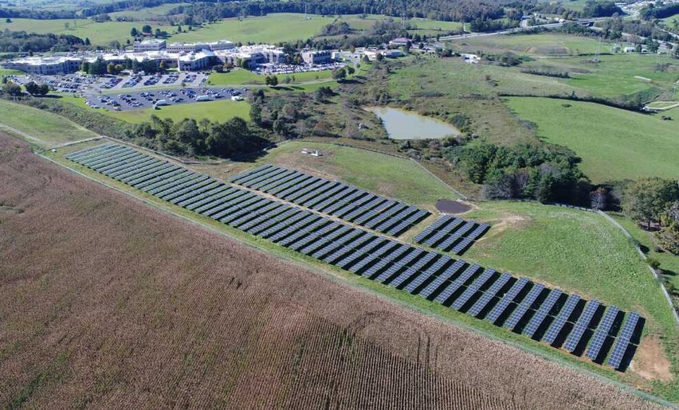
CARILION NEW RIVER VALLEY MEDICAL CENTER
A HOSPITAL WITH A HOLISTIC VISION OF HEALTH
SYSTEM SIZE 1.3 MW
YEAR INSTALLED 2018
NUMBER OF HOMES SYSTEM COULD POWER 135
CUSTOMER SAVINGS $16.3 MILLION OVER 35 YEARS

Slide 31
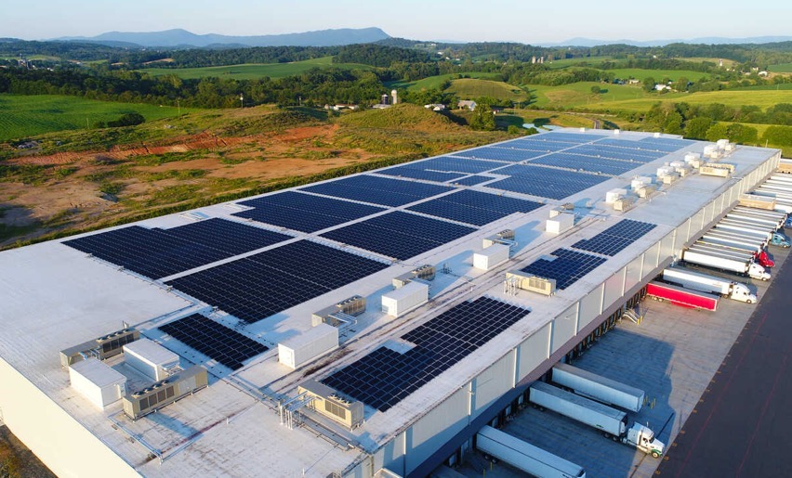
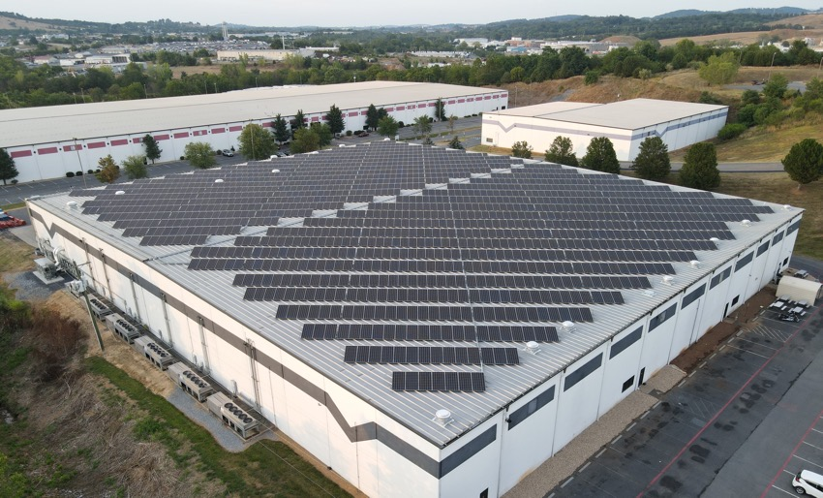
INTERCHANGE GROUP
A PATH TO A GREENER DELIVERY OF LOGISTICS
SYSTEM SIZE 1.6 MW
YEAR INSTALLED 2019
NUMBER OF HOMES SYSTEM COULD POWER 160
CUSTOMER SAVINGS $4.9 MILLION OVER 35 YEARS

Slide 32
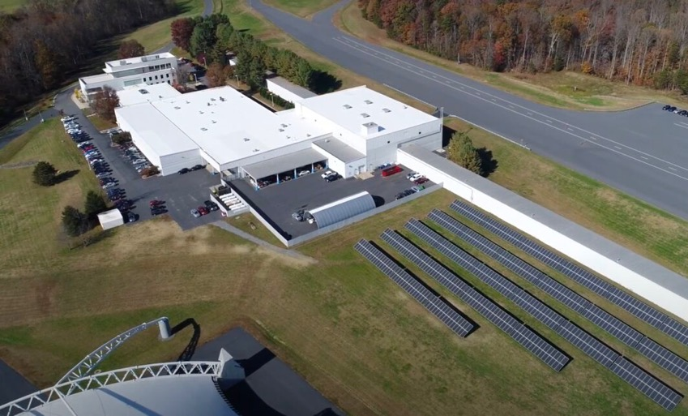
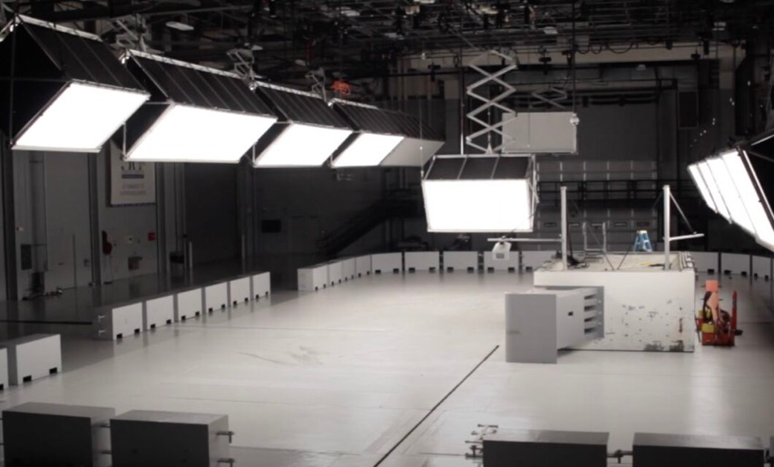
IIHS VEHICLE RESEARCH CENTER
CLEAN ENERGY DRIVES AUTOMOTIVE SAFETY
SYSTEM SIZE 465 kW
YEAR INSTALLED 2017
NUMBER OF HOMES SYSTEM COULD POWER 47
CUSTOMER SAVINGS $966,000 OVER 35 YEARS

Slide 33
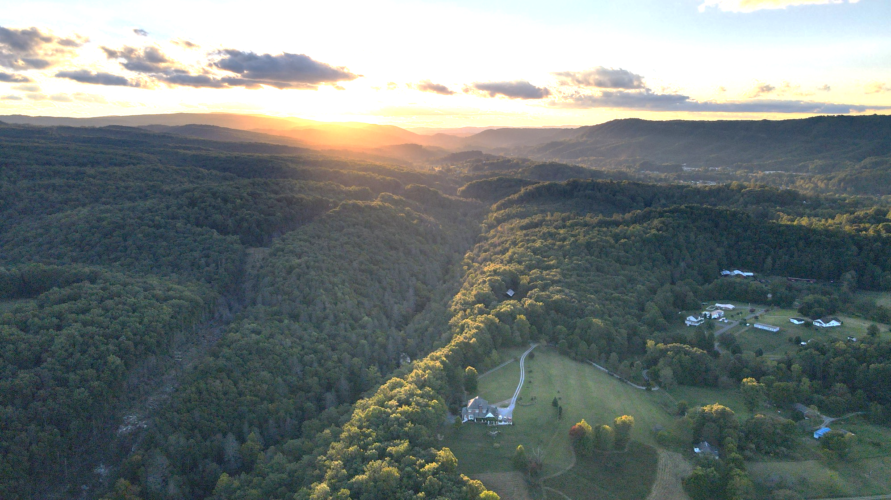
Your Project

Slide 34
YOUR SOLAR LOCATION
[Place Image of Customer Location Here]

Slide 35
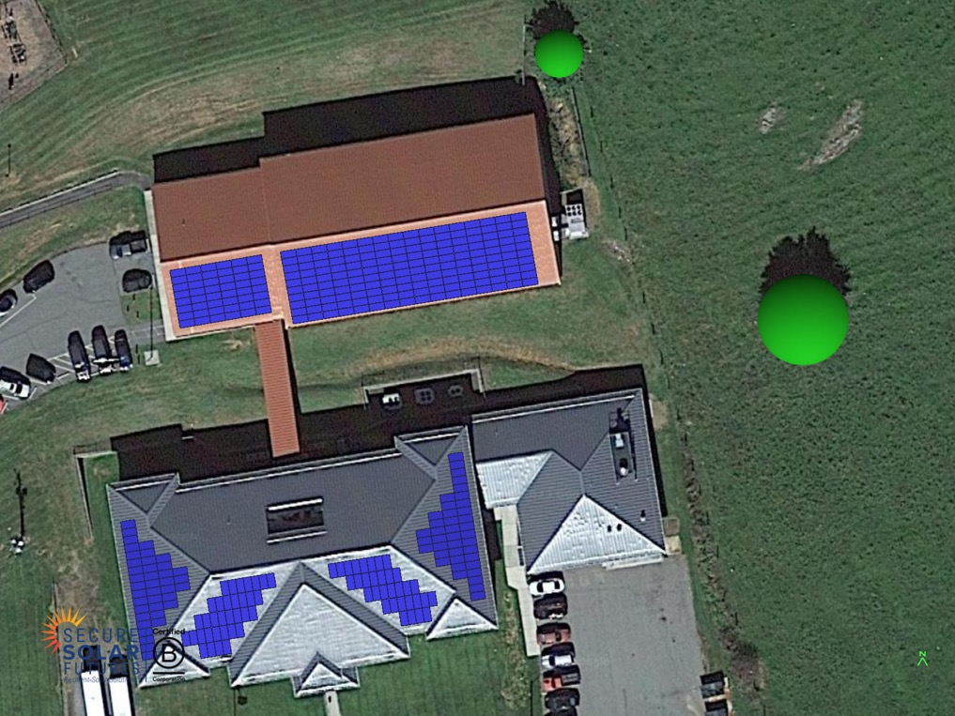
PROJECT DESIGN
NAME OF SITE
ARRAY SIZE DC (kW)
XXX.X kW
OUTPUT YEAR 1
XXX,XXX kW
ENERGY OFFSET
XX.XX%

Slide 36
PROJECT SUMMARY
SOLAR READY-NO ROOF RESTORATION
ARRAY SIZE (kw)
kW OUTPUT YEAR 1
ENERGY OFFSET
Site 1
Site 2
Site 3
Site 4
Totals
XXX.X
XXX.X
XXX.X
XXX.X
X,XXX.X
X,XXX,XXX
XXX,XXX
XXX,XXX
XXX,XXX
X,XXX,XXX
XX.XX%
XX.XX%
XX.XX%
XX.XX%
XX.XX%
SOLAR READY with ROOF RESTORATION
ARRAY SIZE (kw)
kW OUTPUT YEAR 1
ENERGY OFFSET
Site 1
Site 2
Site 3
Site 4
Totals
900.2
162.8
343.6
380.9
X,XXX.X
XXX,XXX
XXX,XXX
XXX,XXX
XXX,XXX
X,XXX,XXX
XX.XX%
XX.XX%
XX.XX%
XX.XX%
XX.XX%

Slide 37
ECONOMIC SUMMARY
SOLAR READY-NO ROOF RESTORATION
YEAR 1
YEAR 25
YEAR 35
Avoided Cost of Energy
Solar Service Fee
Projected Net Energy Savings
$XXX,XXX
-$XXX,XXX
$XX,XXX
$X,XXX,XXX
-$X,XXX,XXX
$X,XXX,XXX
$XX,XXX,XXX
-$X,XXX,XXX
$X,XXX,XXX
PROJECTED ANNUAL SAVINGS OVER TERM OF AGREEMENT
$XX,XXX
SOLAR ELECTRICITY ESCALATION 2%
GRID ELECTRICITY ESCALATION 3%

Slide 38
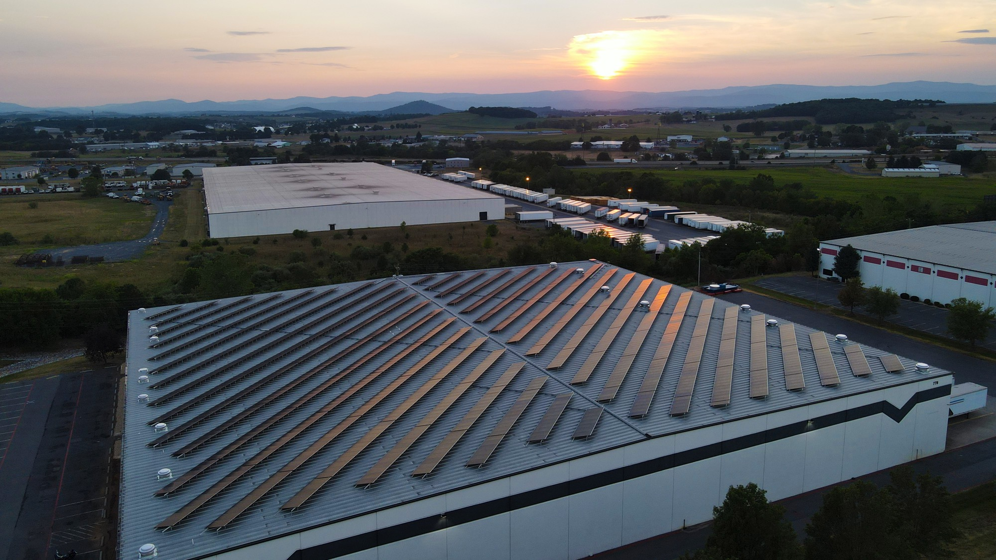
NEXT STEPS
1
2
3
4
5
6
7
JAN 2024
JAN 2024
JAN 2024
JAN 2024
JAN 2024
JAN 2024
JAN 2024
Solar Feasibility Study
Proposal Presentation
Preliminary Engineering
Final Presentation
Board
Approval
Contract Execution
Engineering/
Procurement/
Construction
12 Months of Electric Bills
Execute NDA
Execute MOU

Slide 39
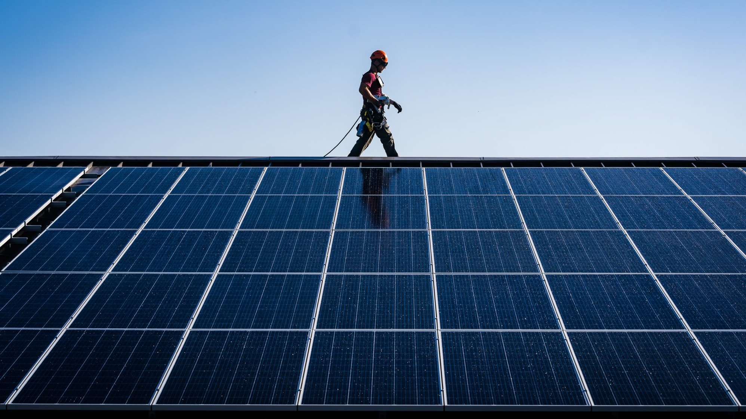
Thank You!

